Slide 1
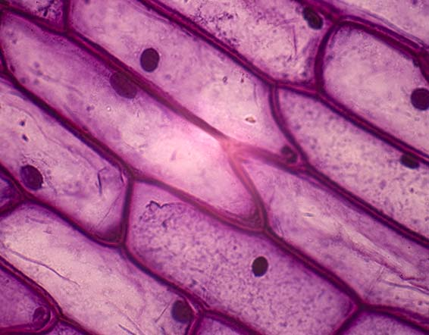
What is the smallest living unit of life?
Atoms
Nucleus
Cells
Tissues
Cells!

Slide 2
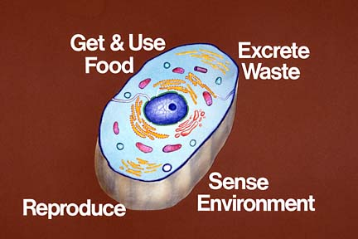
Now that we know the basics of chemistry…
We can use that knowledge to see what our cells are made of & how those components help the cell function.

Slide 3
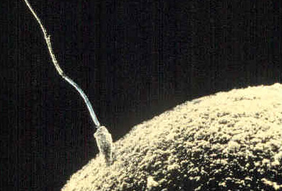
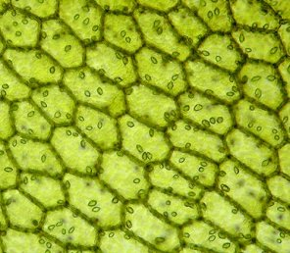
Cells are the basic unit of life.
This means that every individual cell is a living structure.
Cells often work together to form tissues & organs.
Here, a sperm cell fertilizes an egg cell.
These are plant cells in leaf tissue.

Slide 4
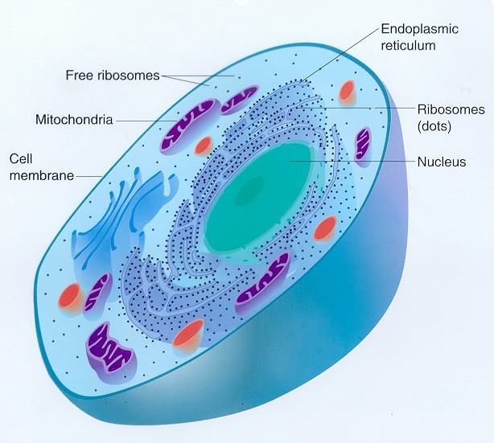
Cell Biology
The study of the basic unit of life, cells
Cells are the smallest living unit, but they are composed of smaller subparts of molecules & macromolecules.

Slide 5
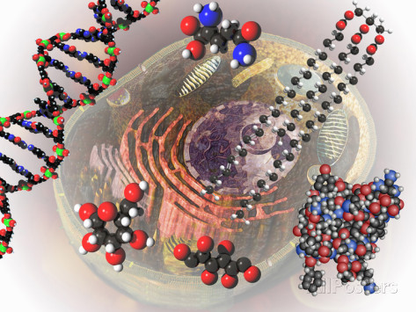
The main components of cells are organic molecules.
Organic molecules are molecules that contain carbon.
Carbon has special properties that make life possible!

Slide 6
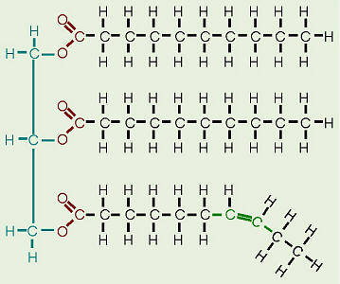
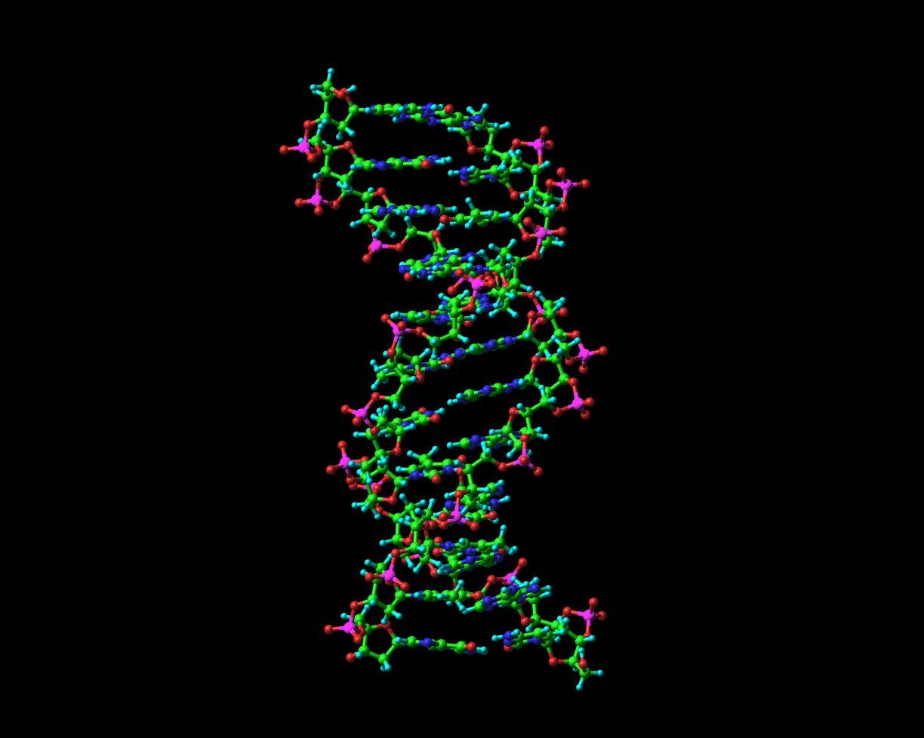
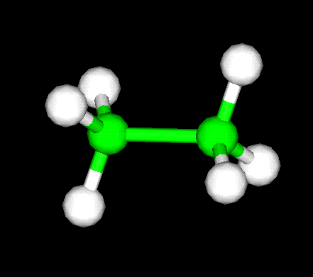
Carbon Compounds

Slide 7
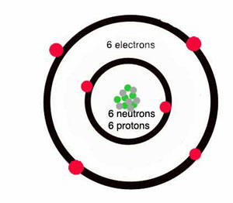
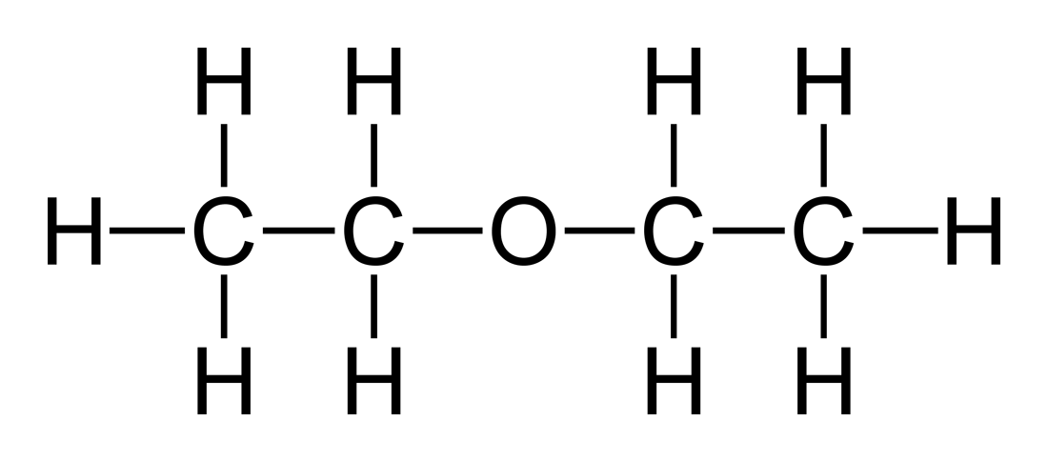
The Chemistry of Carbon
Carbon can form 4 covalent bonds.
Carbon can bond with hydrogen, oxygen, phosphorous, sulfur, nitrogen, & more carbon.

Slide 8
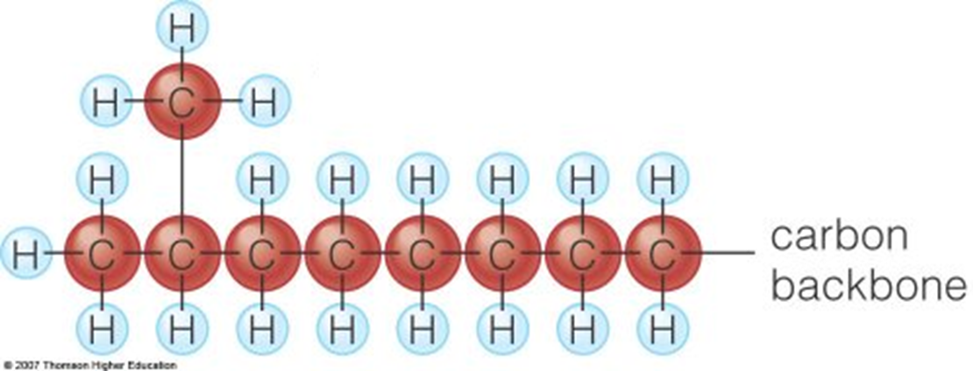
What makes carbon so special?
Carbon is the most important element in your body, because it can form long chains & large molecules.

Slide 9
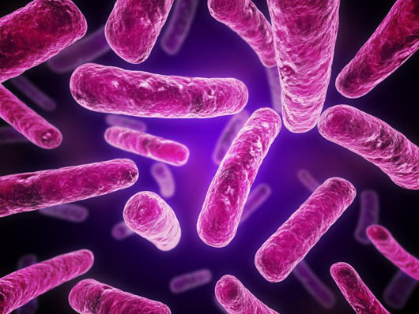
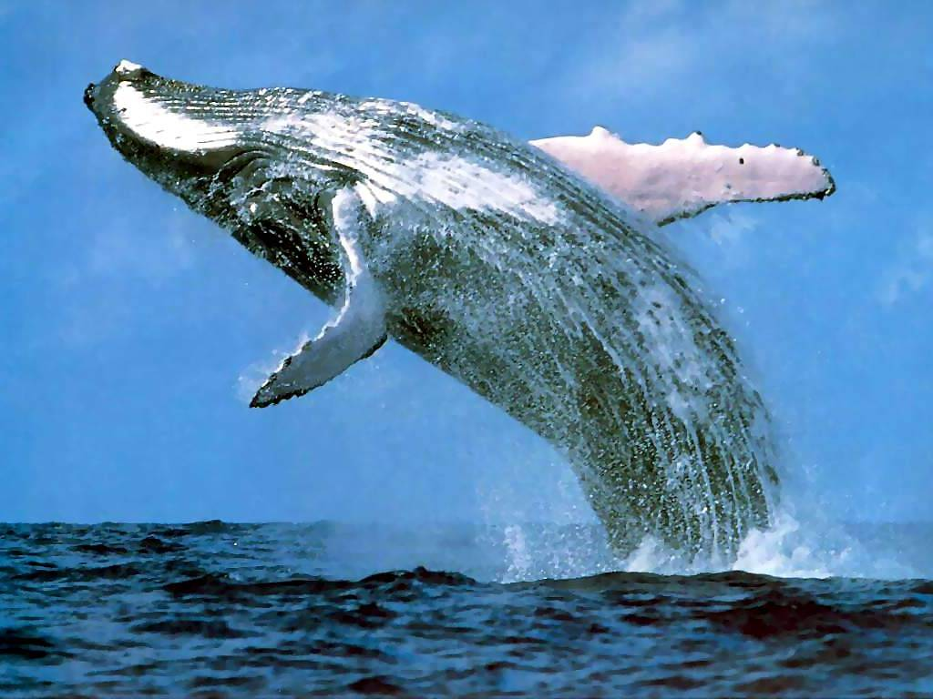
What do these words mean?
“Micro”
“Macro”

Slide 10
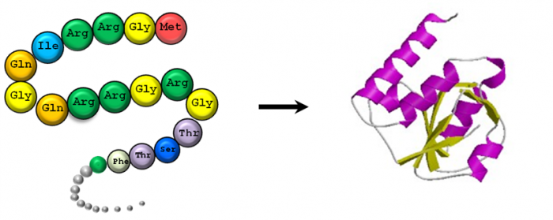
So what is a macromolecule?
A “giant molecule”
Consists of many smaller units linked together
The biological macromolecules are organic molecules (contain the element carbon).

Slide 11
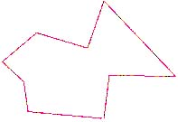
What does “poly” mean?
Polygons
Polygamy
“Poly” means MANY!
… & “mono” means one!

Slide 12
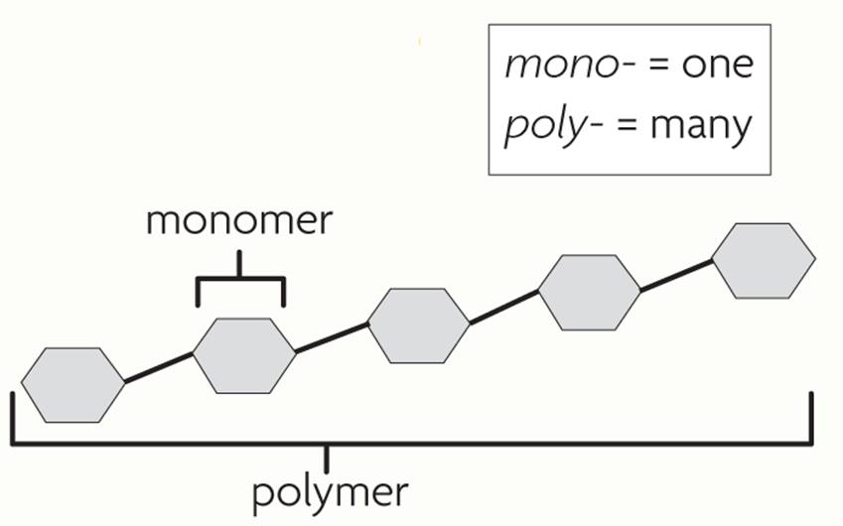
Macromolecules are polymers.
Macromolecules are large molecules (polymers) made of small subunits (monomers) linked together.

Slide 13
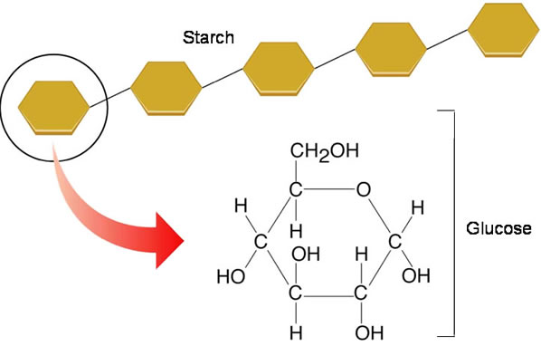
Macromolecules are polymers.
When glucose molecules (monomers) link together, they form starch (polymer).
What’s the macromolecule – starch or glucose?

Slide 14
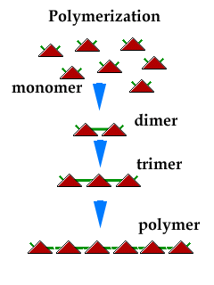
Polymerization
Monomers (small units) join together to form polymers.

Slide 15
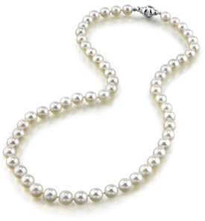
Polymer Analogies
Polymer | Monomer
A train
A pearl necklace
Each train car
Each pearl

Slide 16
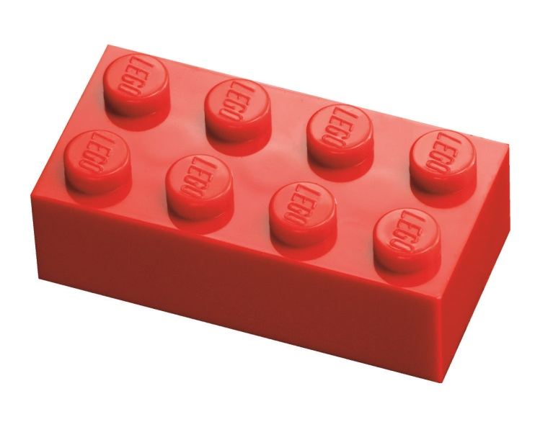
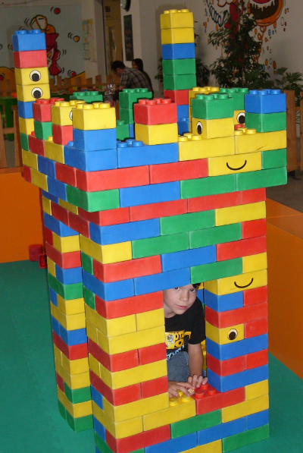
A monomer is like a single Lego block…
A polymer is like a Lego tower!

Slide 17
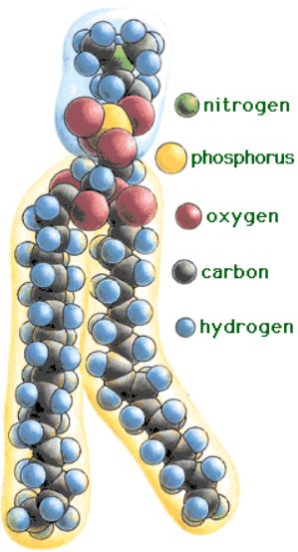
The 4 Macromolecules of Life
Carbohydrates
Lipids
Proteins
Nucleic Acids
These macromolecules are what make up the cells in your body & help your cells to function.

Slide 18
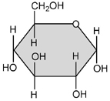
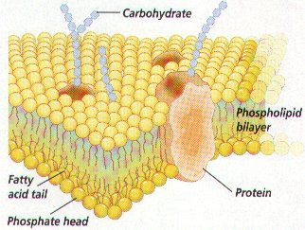
Carbohydrates contain carbon, hydrogen, & oxygen
Glucose
Functions:
Main source of energy for cells
ID tag on cell membrane
Examples:
Sugars
Starches

Slide 19
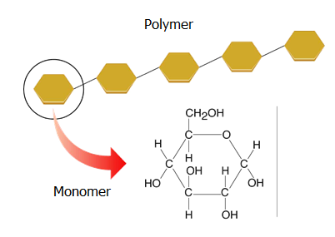
Carbohydrates
Monomer: monosaccharides
Simple sugars
Polymer: polysaccharides
Complex carbs (starch, cellulose, glycogen)
Carbohydrate Monomer: Monosaccharide
Carbohydrate Polymer: Polysaccharide

Slide 20
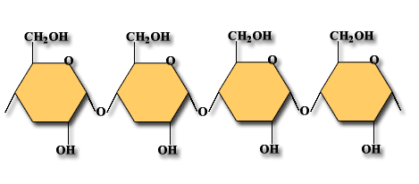
What is the main function of carbohydrates?
Main part of the cell membrane
Hereditary material
Energy
Builds muscles
Energy!

Slide 21
What is the monomer of carbohydrates?
Fatty Acids
Nucleotides
Monosaccharides
Amino Acids
Monosaccharides!

Slide 22
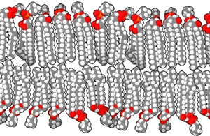
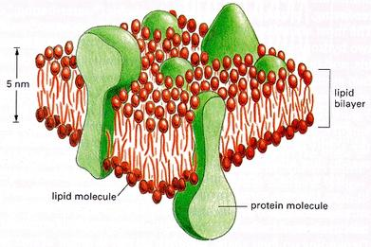
Lipids contain carbon, hydrogen, & oxygen
Functions:
Main component of the cell membrane
Can be used to store energy

Slide 23
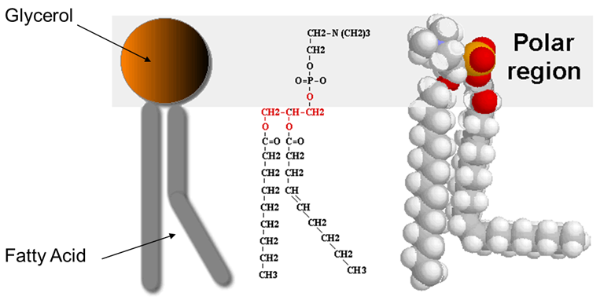
Lipids
Subunits: glycerol + fatty acid

Slide 24
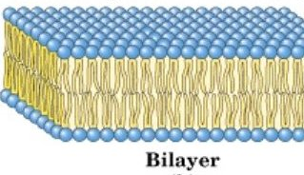
Lipids
The heads of lipids (glycerol) are hydrophilic (water loving).
The tails (fatty acids) are hydrophobic (water fearing).
In the cell membrane, the fatty acid tails turn in to the interior & the glycerol heads form the exterior.
This forms a lipid bilayer.

Slide 25
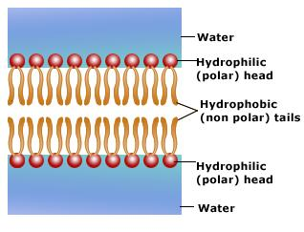
Remember, the environment in & around cells is mostly water. This is why the fatty acid tails turn in on themselves (to escape the water)!
The glycerol head is polar (loves water).
The fatty acid tails are nonpolar (fears water).

Slide 26
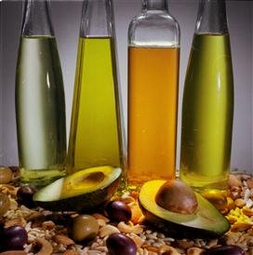
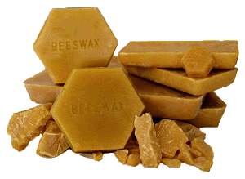
Examples of Lipids
Fats
Oils
Waxes
Steroids (cholesterol)

Slide 27
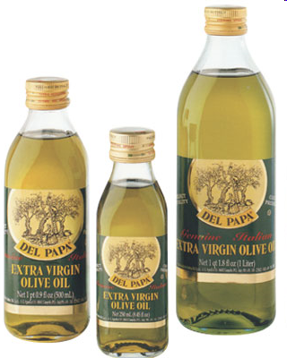
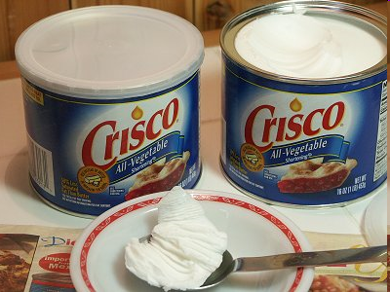
Types of Lipids
Unsaturated Fatty Acids: found in lipids that are liquid at room temperature
Olive Oil
Saturated Fatty Acids: found in lipids that are solid at room temperature
Shortening or Butter

Slide 28
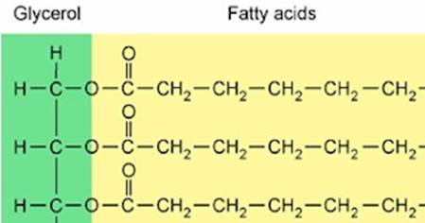
Saturated vs. Unsaturated Fatty Acids
Saturated: only single bonds, max # of H atoms
Unsaturated: at least 1 C=C double bond

Slide 29
What is the main function of lipids?
Main part of the cell membrane
Hereditary material
Energy
Builds muscles
Cell membrane!

Slide 30
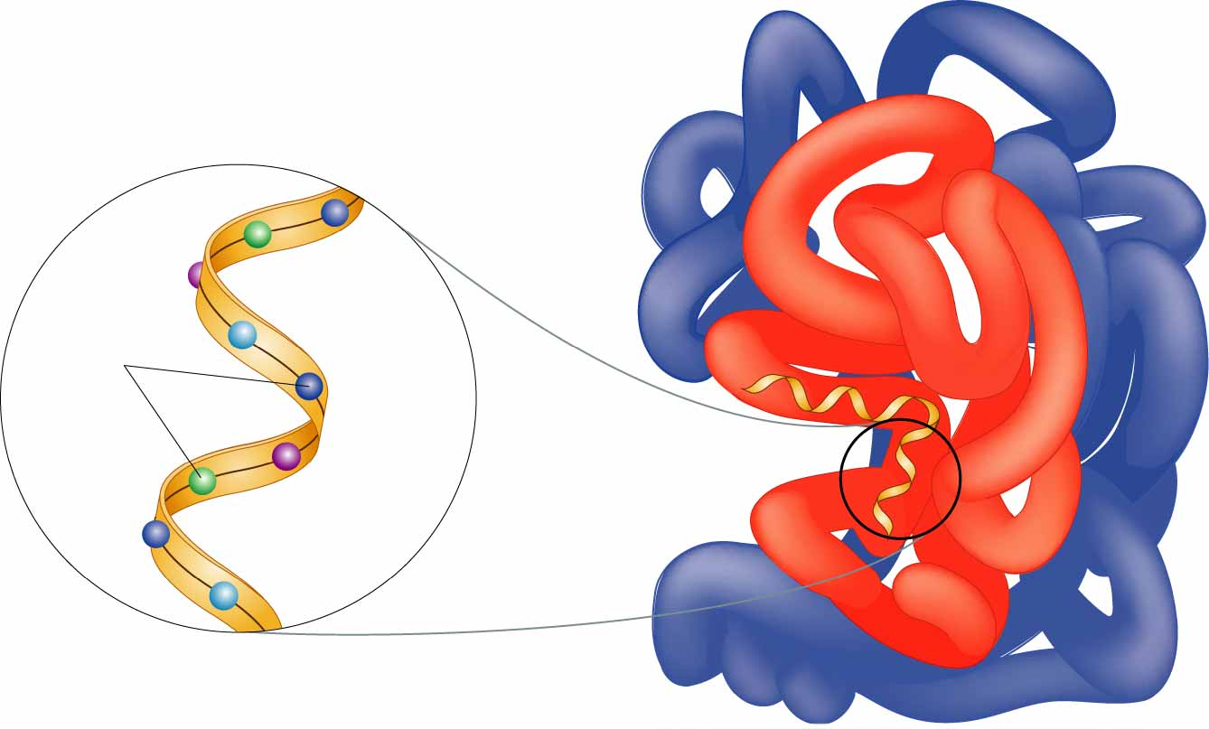
Proteins contain carbon, hydrogen, oxygen, & nitrogen
Functions:
Control cell processes
Build bones & muscles
Help fight disease
Enzymes
Protein channels in cell membrane

Slide 31
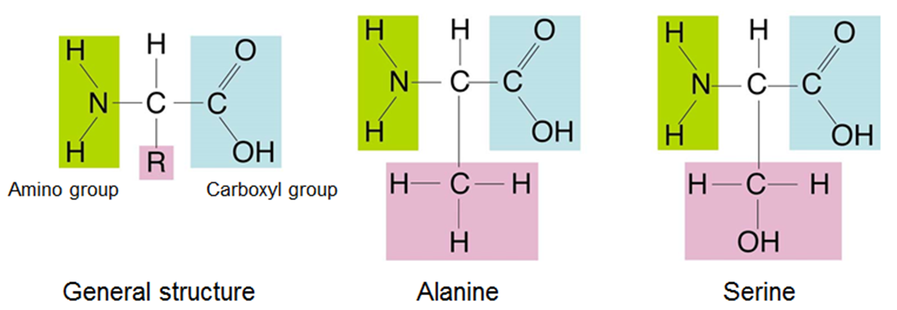
Proteins
Monomers: amino acids
20 types of amino acids
Same general structure, but different R group

Slide 32
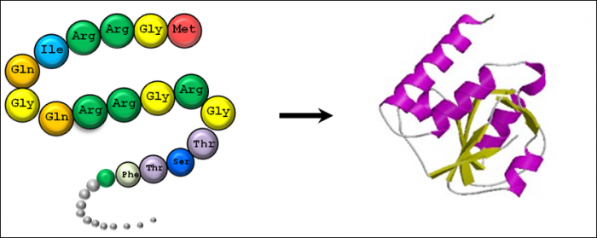
Proteins
Monomers: amino acids
Polymer: polypeptide

Slide 33
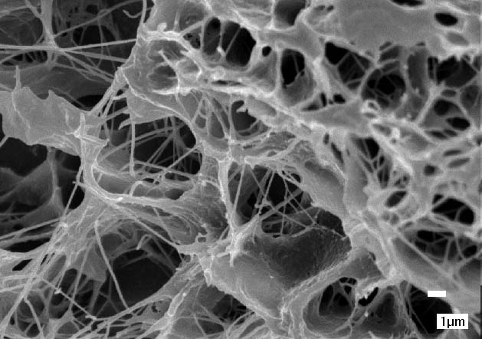
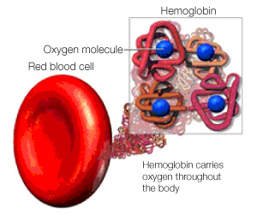
Protein Examples
Collagen: structural protein in connective tissues (like skin)
Most abundant protein in mammals!
Hemoglobin: carries oxygen through the blood

Slide 34
What is the monomer of proteins?
Fatty Acids
Nucleotides
Monosaccharides
Amino Acids
Amino Acids!

Slide 35
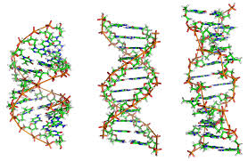
Nucleic Acids contains carbon, hydrogen, oxygen, nitrogen, & phosphorous
Function:
Store & transmit genetic information

Slide 36
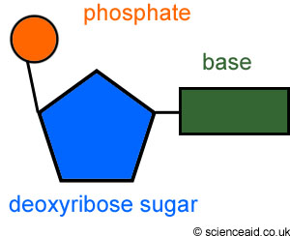
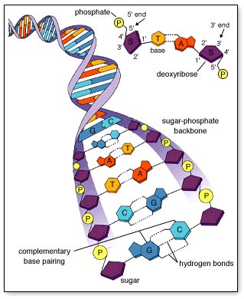
Nucleic Acids
Monomers: nucleotides
Polymers:
DNA: Deoxyribonucleic Acid
RNA: Ribonucleic Acid

Slide 37
What is the main function of nucleic acids?
Main part of the cell membrane
Hereditary material
Energy
Builds muscles
Hereditary material!

Slide 38
Which of the following is not found in a nucleotide?
Phosphate
Sugar
Glycerol
Base
Glycerol!

Slide 39
